Slide 1
Employee Leave Management System
Naresh babu O

Slide 2
Submitted by:
NARESH BABU O
HDFC API batch-1 in Manipal Global Skill Academy

Slide 3
Supervisor:
Mr. Javeed Mohammed
trainer from Manipal global skill academy

Slide 4
Technologies
JAVA-8
Spring boot
Rest API
My SQL
Spring Data JPA
Swagger
Validation
Junit

Slide 5
Summary
Executive Summary:
This documentation is provides some information about Employee Leave management System.
The Employee Leave management System application is responsible for applies leave, calculation of leave, and leave approval. This application components related to an employee's "Leave Life cycle" while at an organization. These activities include the Enterprise Structure, Cross-Application Components and Organizational Management.

Slide 6
Possible Solution
Below are certain objectives that should be gain in this project :
To apply leave online/in website (staffs)
To receive leave application from staff and to approve or reject staff leave (Approver/Admin)
To calculate leave balance from a fix amount of annual leave
To record all leave information in database To generate report based on staffs leave

Slide 7
After Approvel
Department in-charge:
The System will automatically update balance in balance table
And The applicant/Employee can check the status of leave request in request table

Slide 8
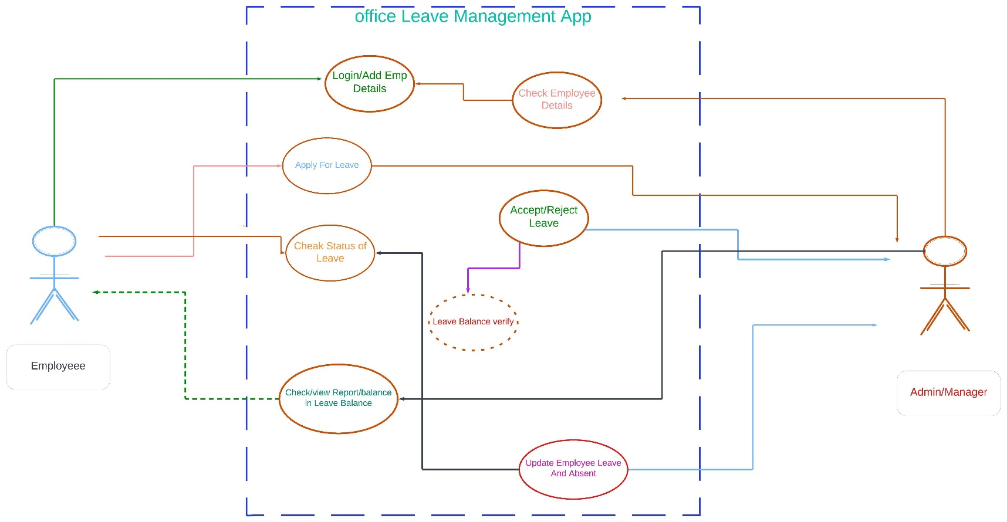
User UML Diagrams

Slide 9
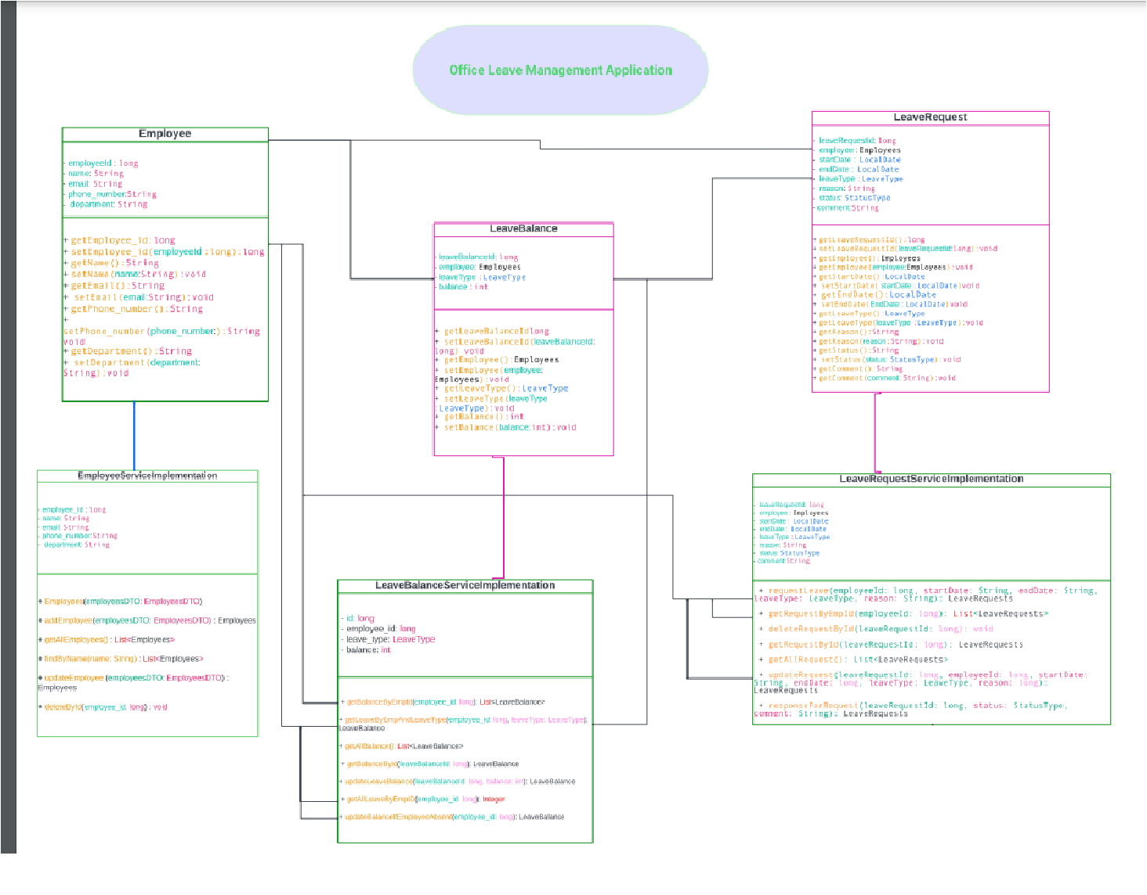
LMS Class Diagrams

Slide 10
ENTITY CLASS

Slide 11
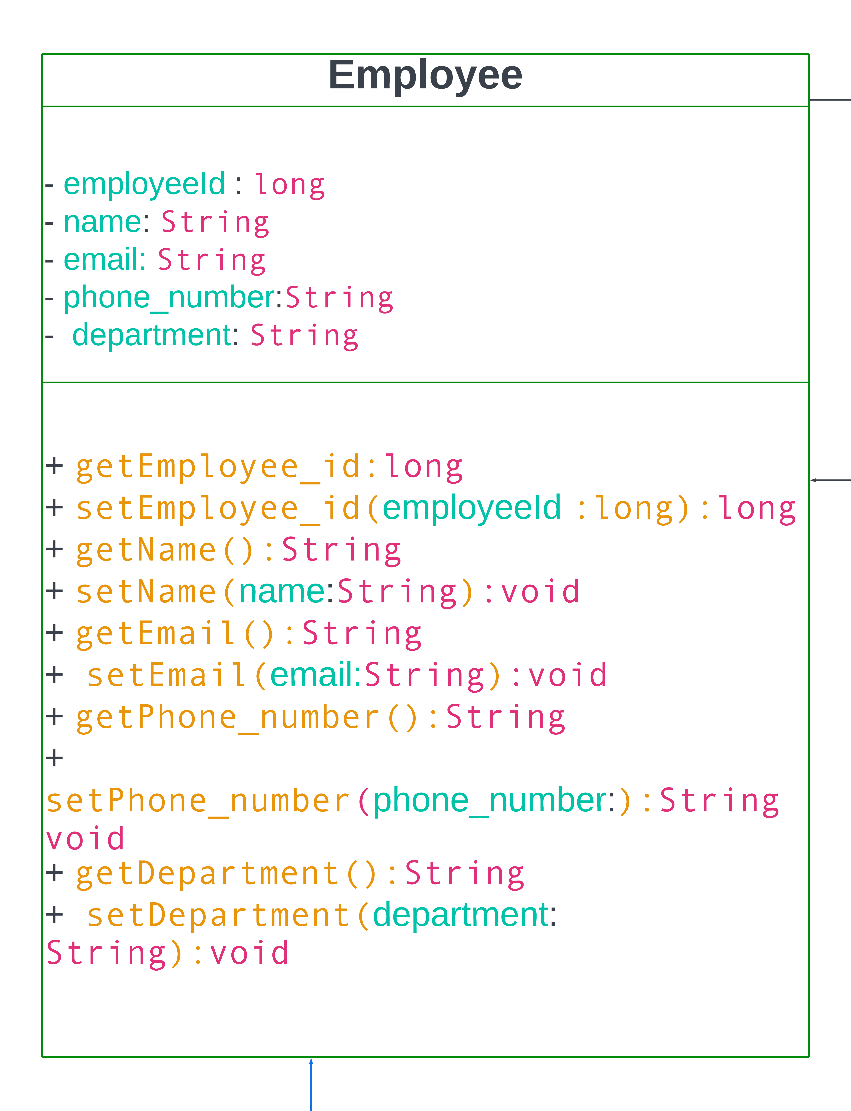
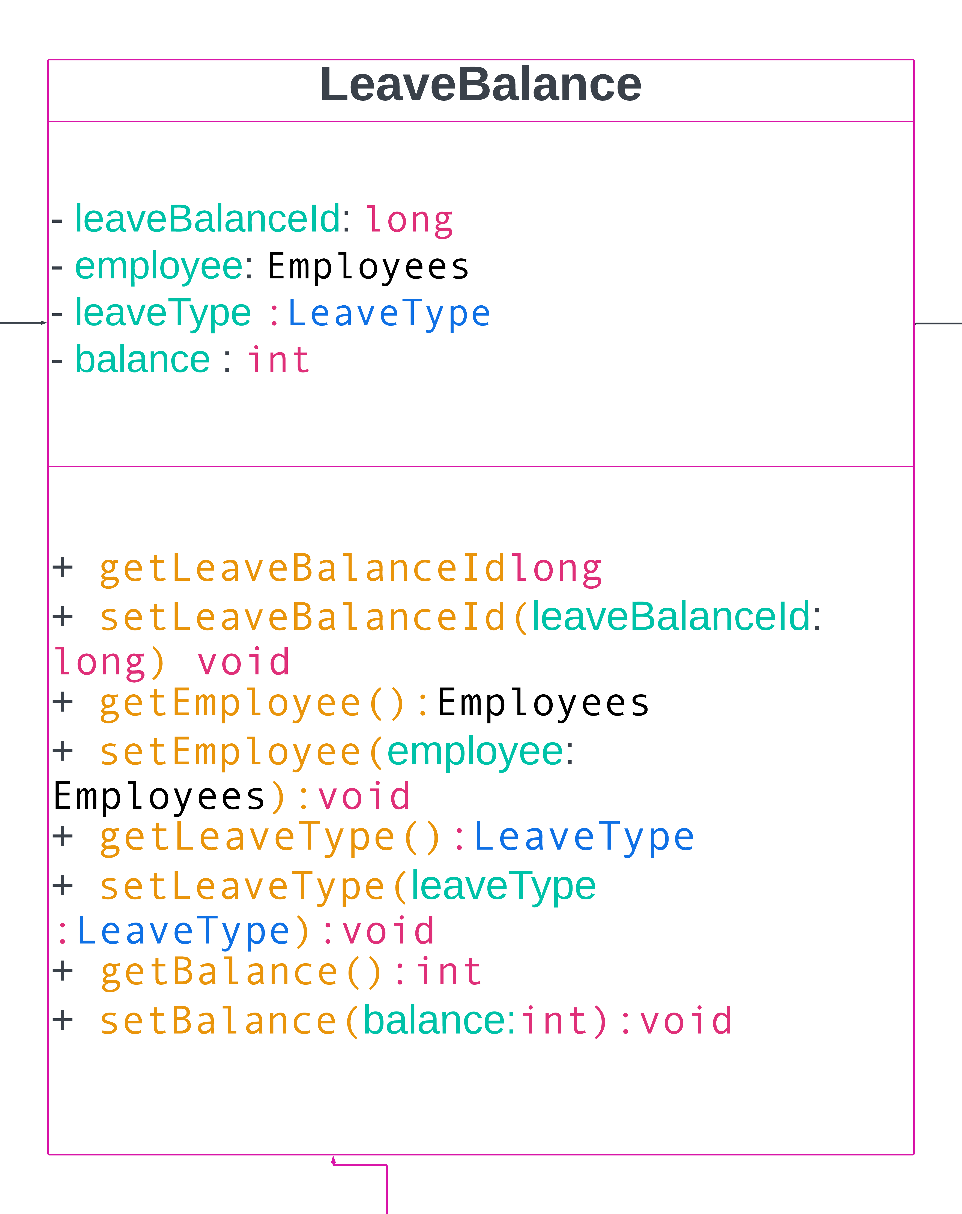
Entity Class Diagrams

Slide 12
BUSINESS LOGIC CLASS

Slide 13
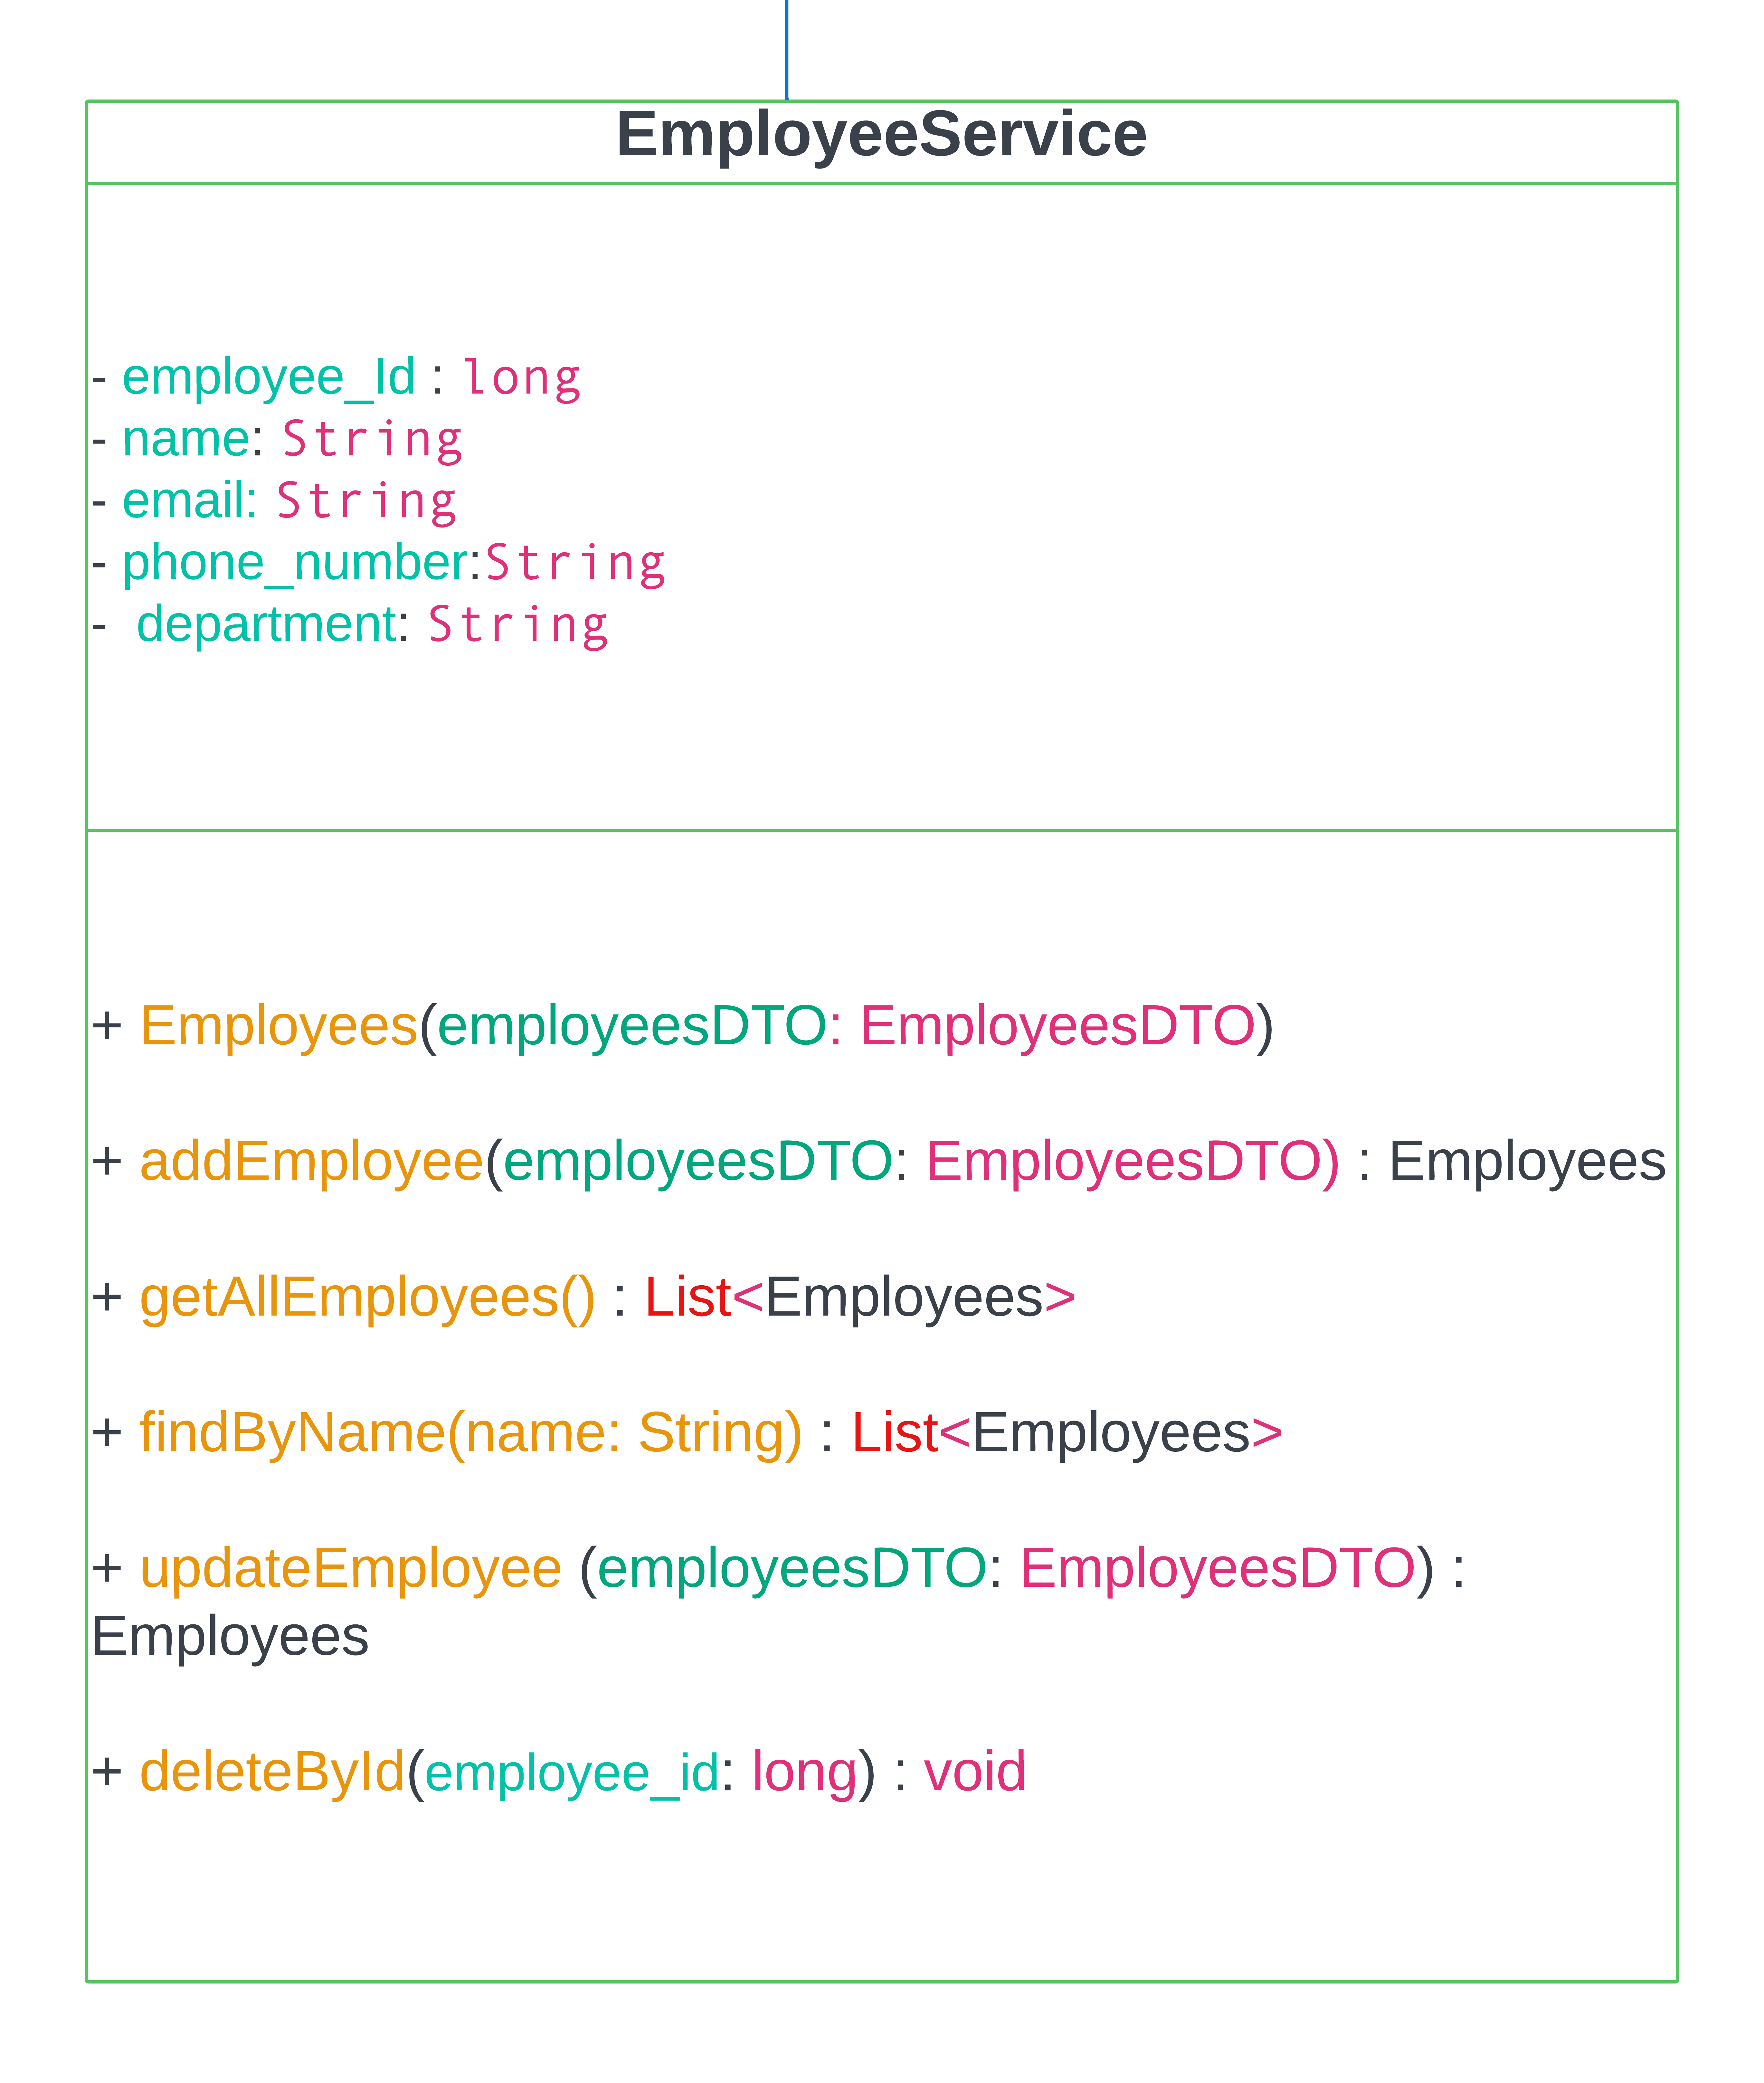
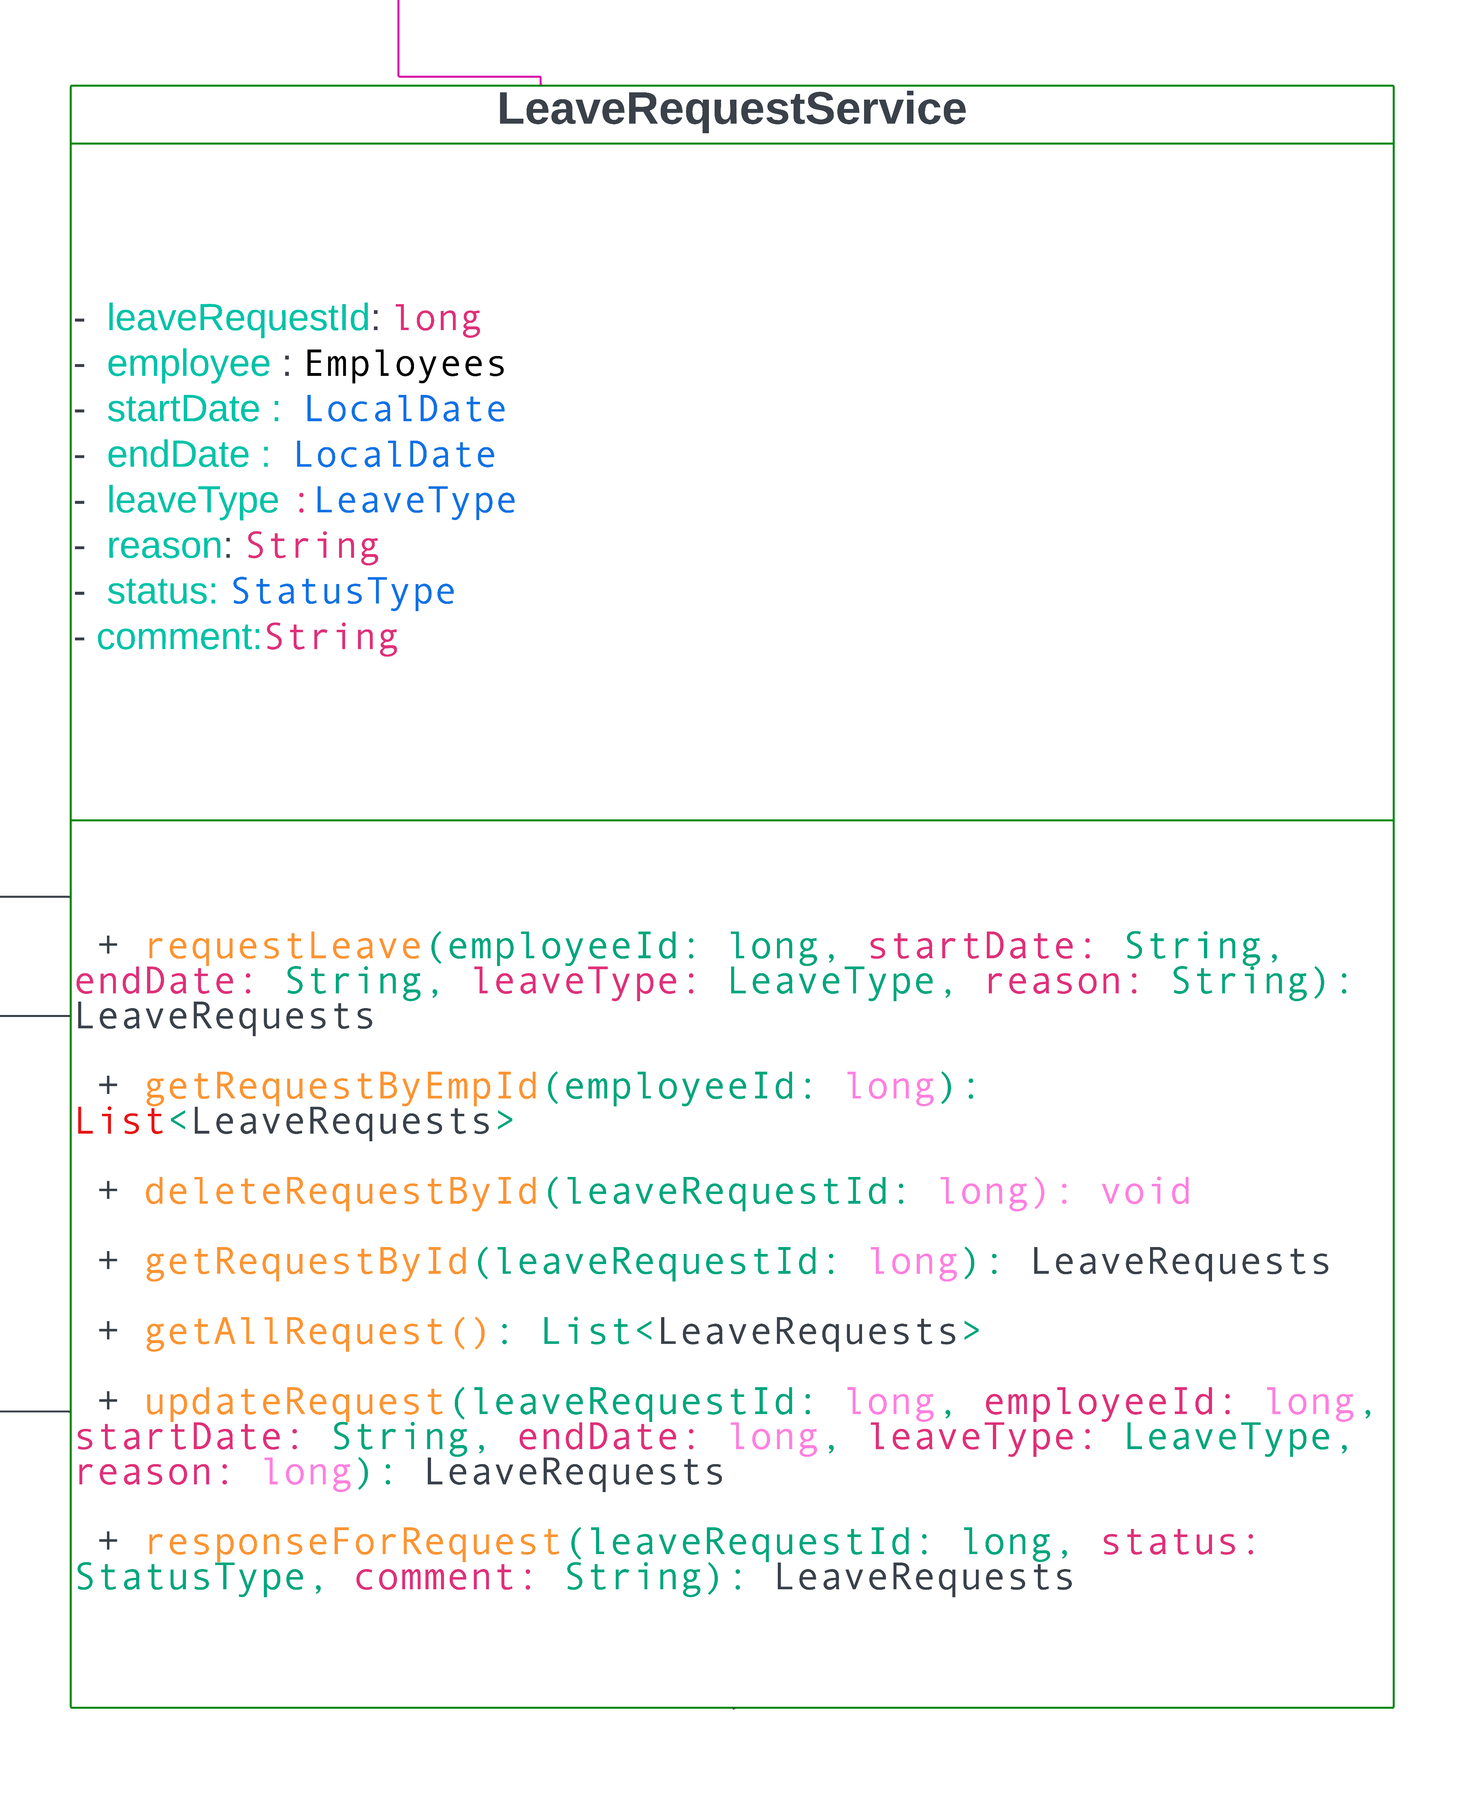
Business Logic Class

Slide 14
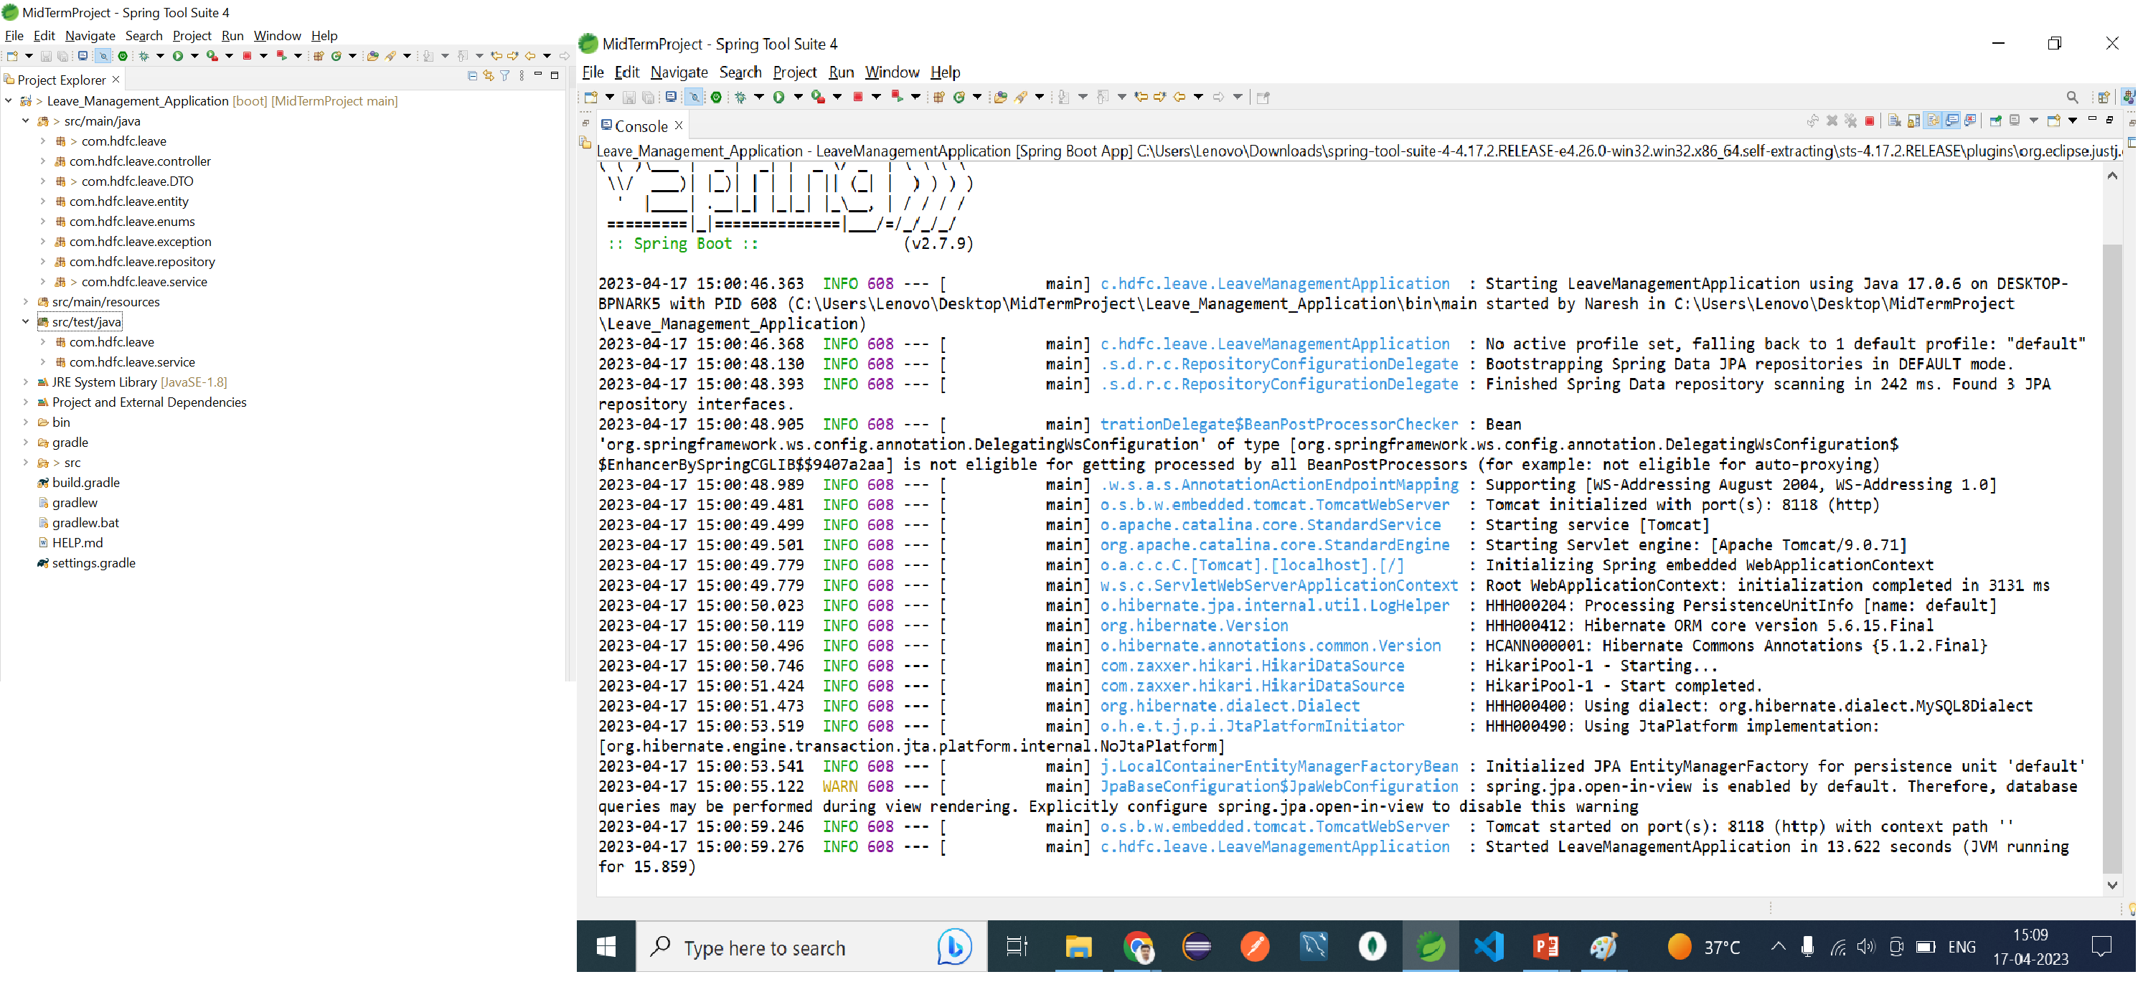
LMS Project- using STS-4 tool

Slide 15
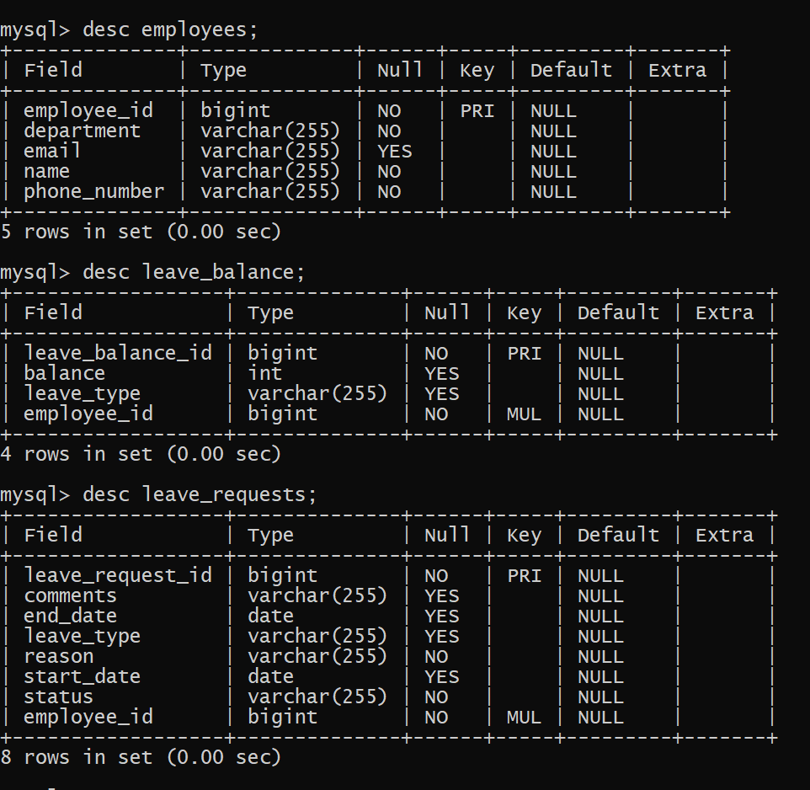
Database

Slide 16
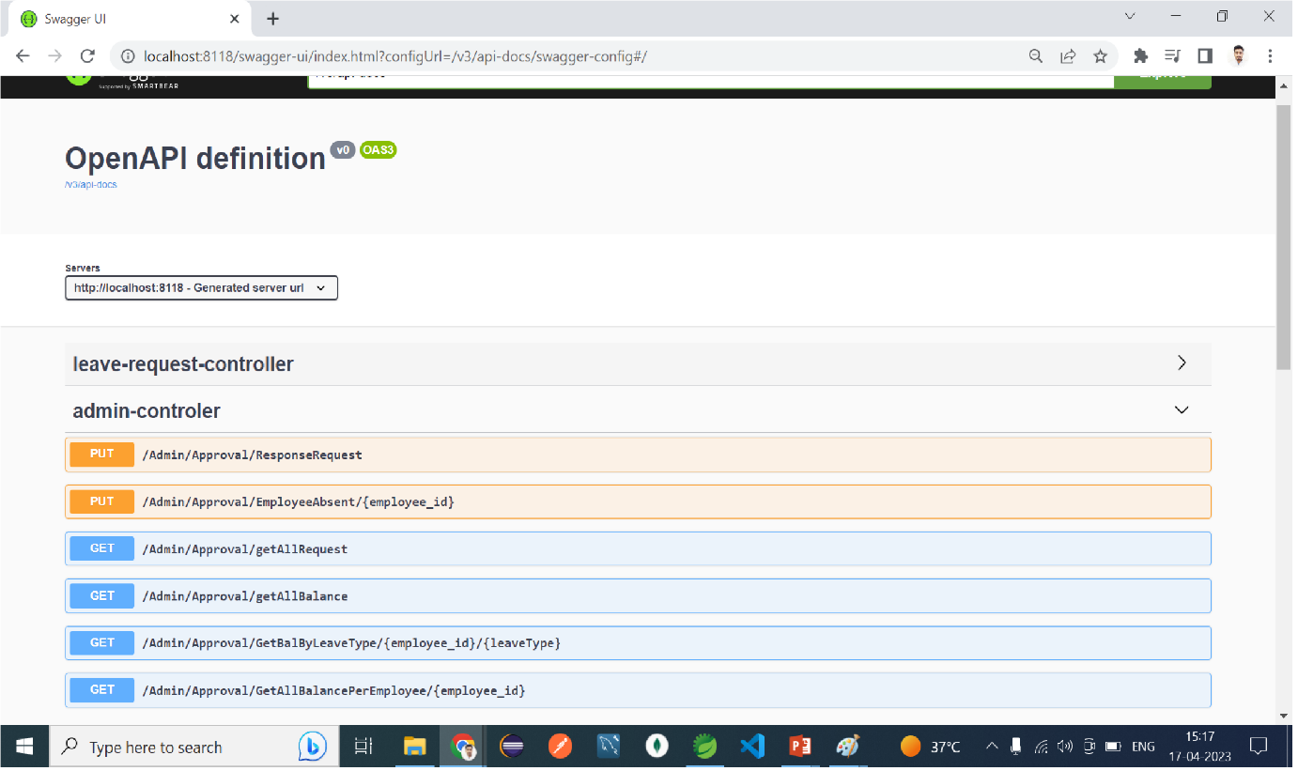
Swagger UI

Slide 17
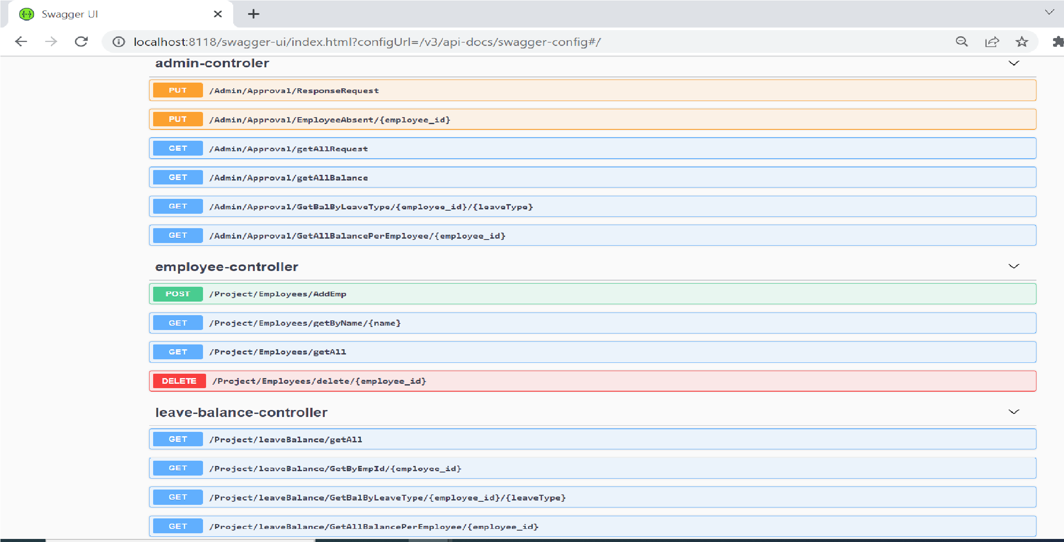
Using Swagger-UI

Slide 18
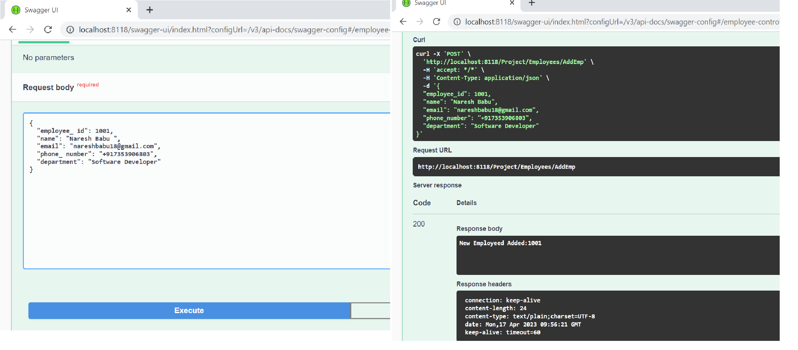
Adding Employee with Output in swagger

Slide 19
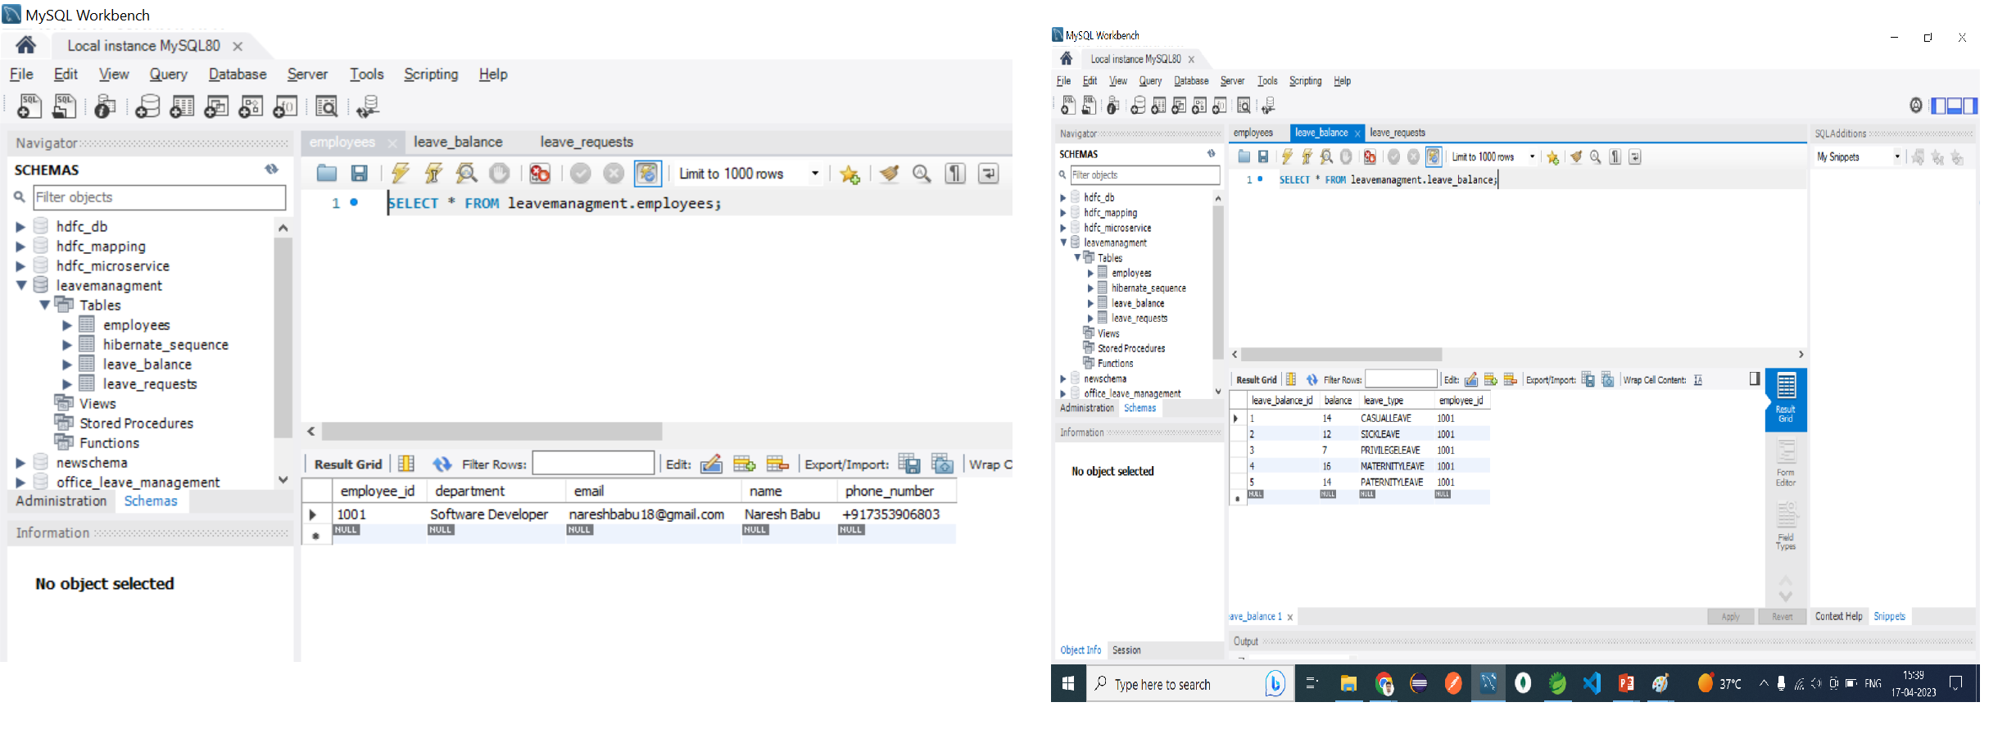
Database Display

Slide 20
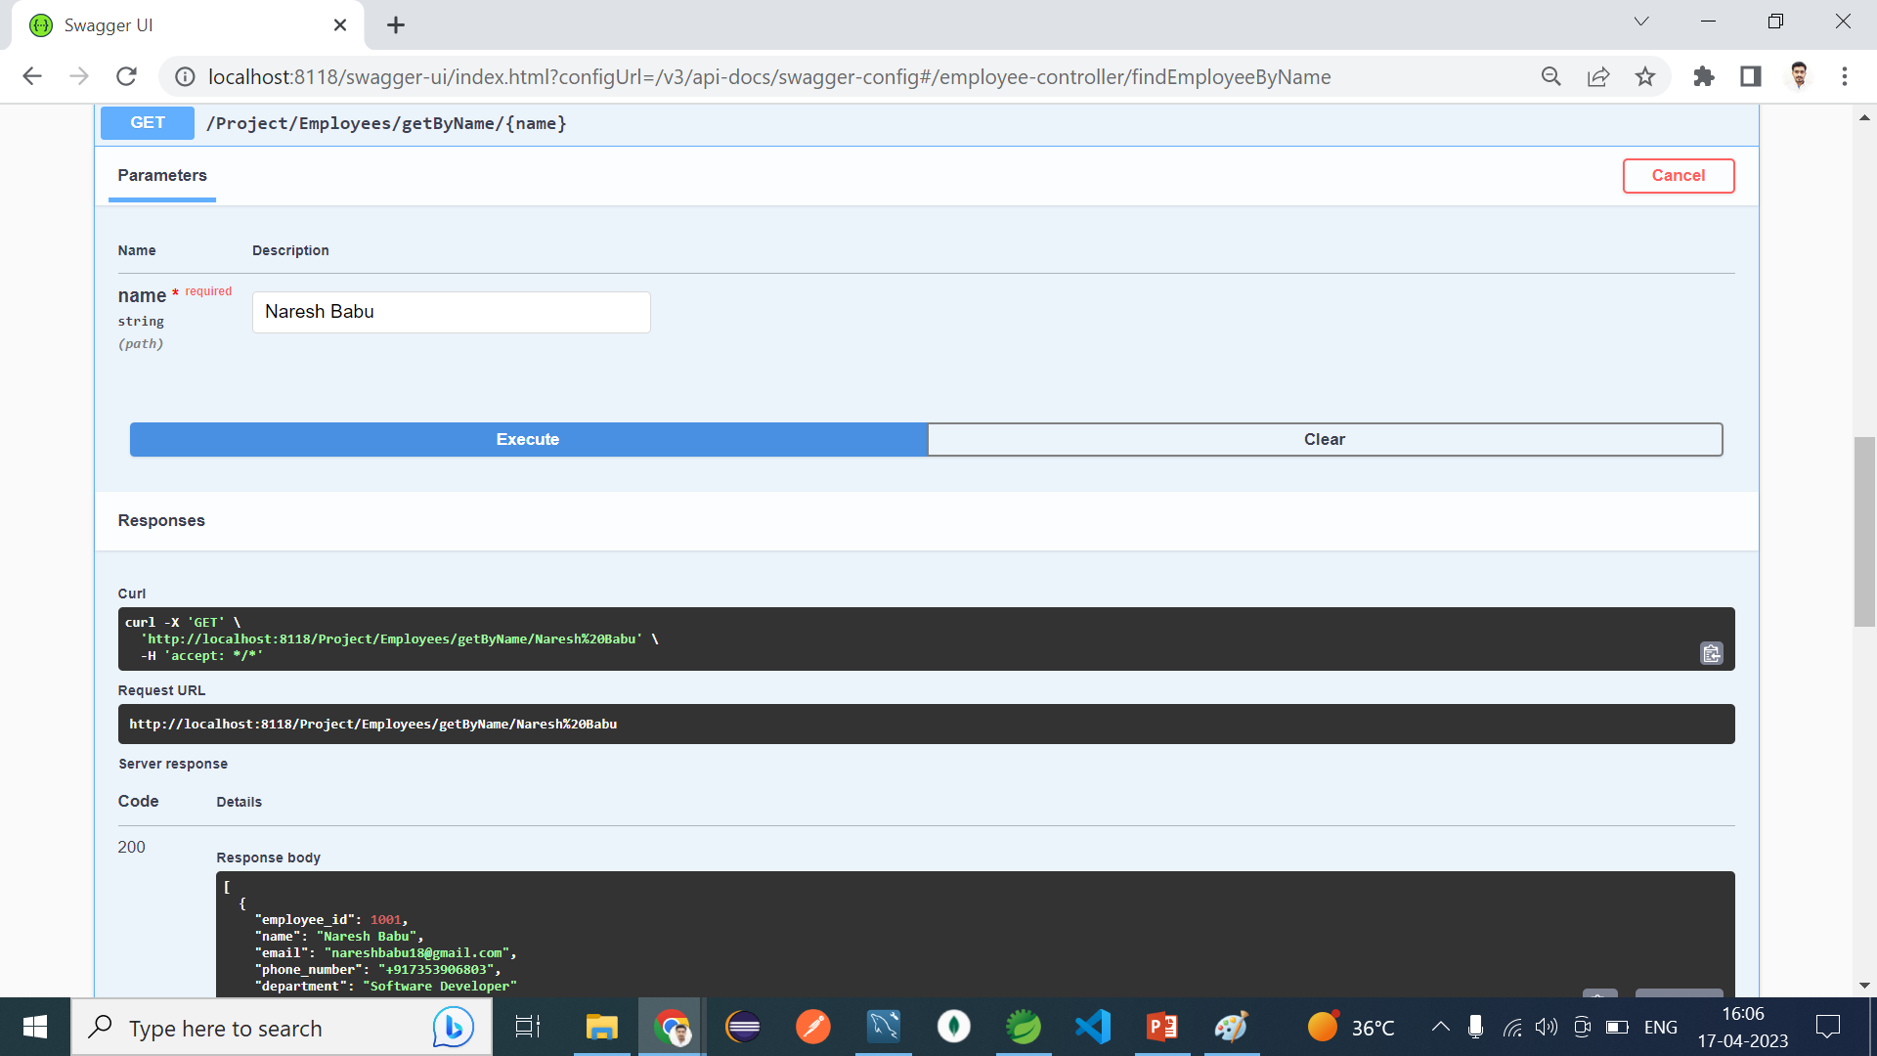
Search By Name

Slide 21
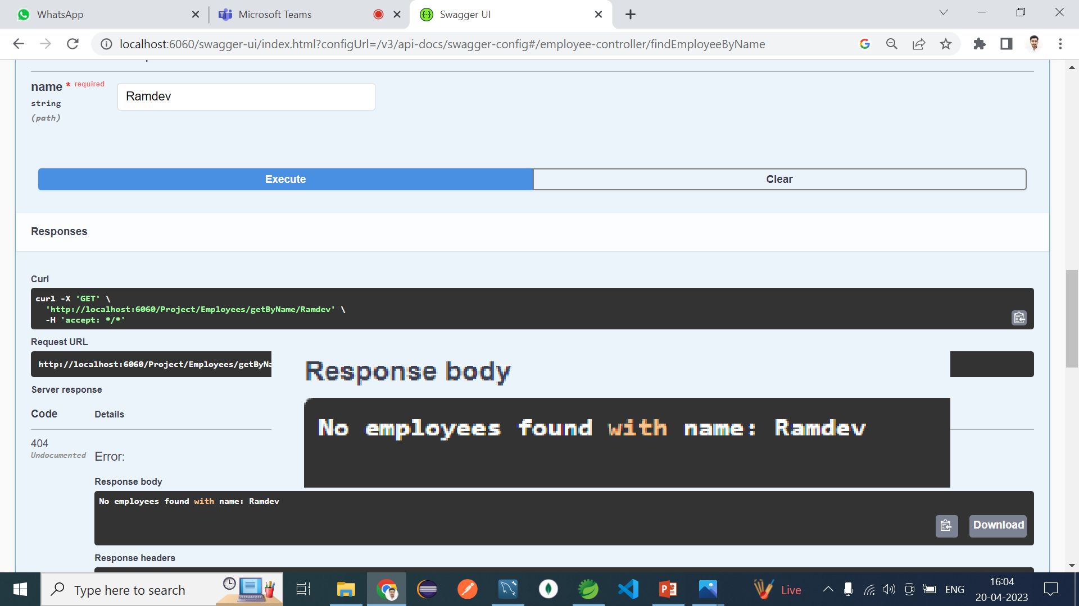
Employee Not Found Exception

Slide 22
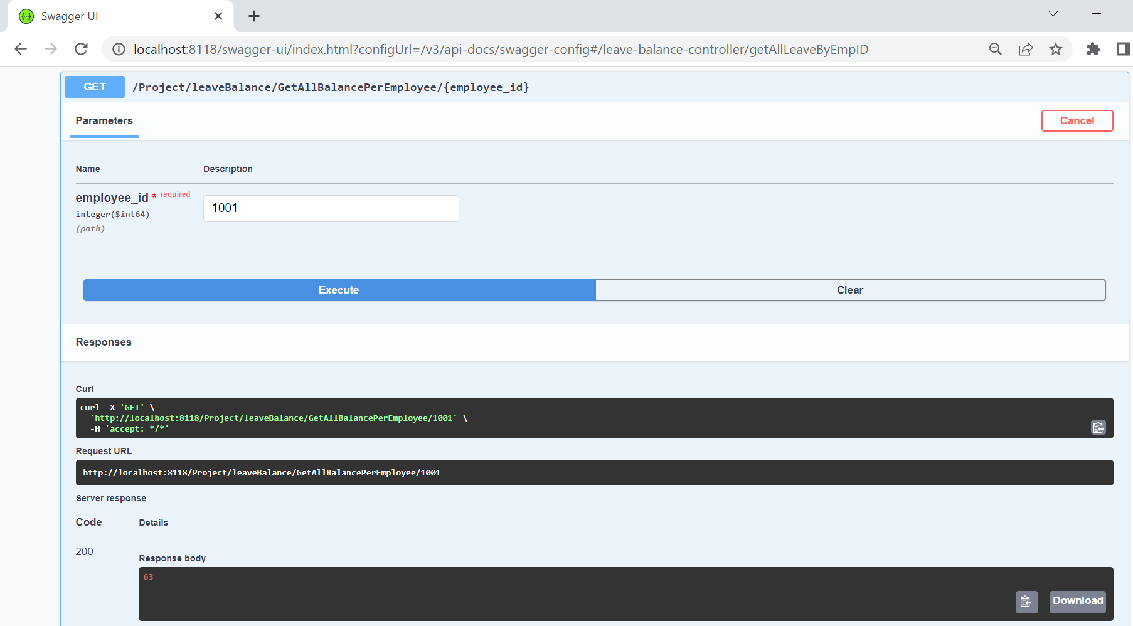
Get Balance By Employee ID

Slide 23
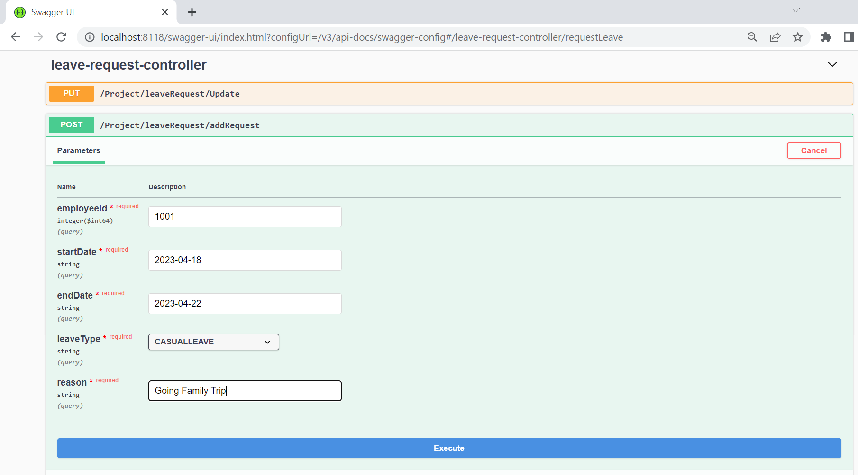
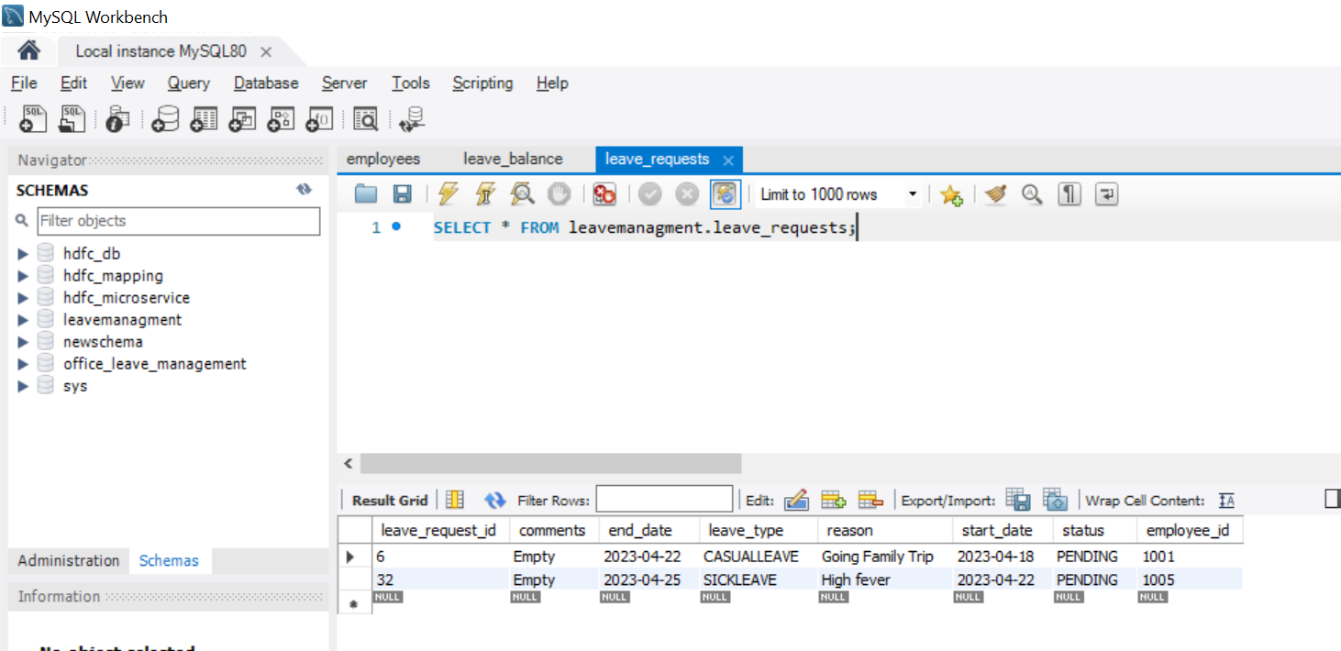
Adding Leave Request

Slide 24
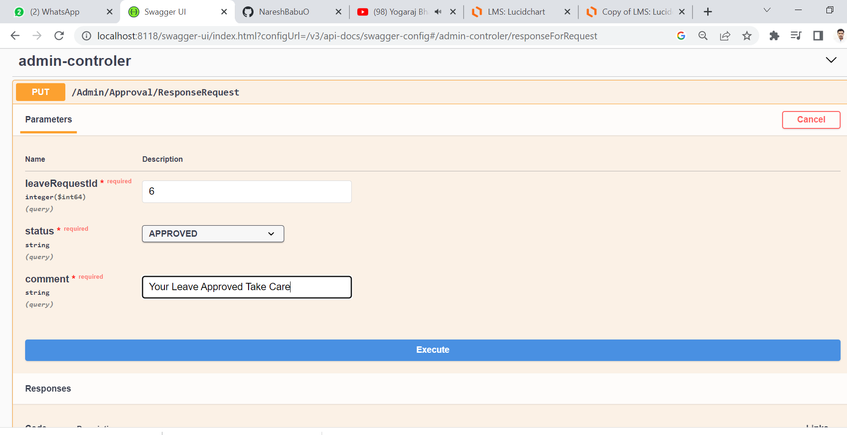
Leave Approval By Admin

Slide 25
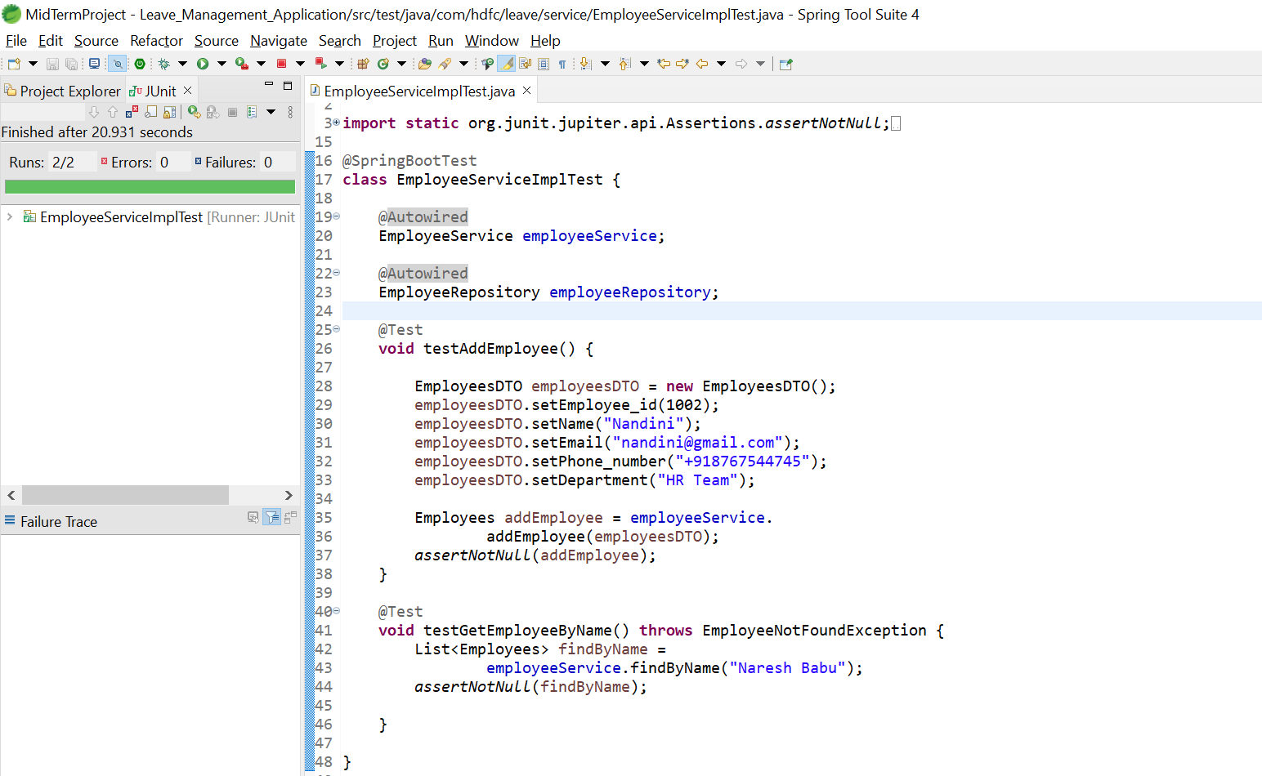
Junit Testing

Slide 26
Conclusion of LMS Project
Conclusion
The proposed Leave Management System will make the whole leave management process efficient. Users will be able to know their leave status.
The employees may be applying for leave from their home as well. This supporting software will help the management in decision making in case of leave related affairs.
Moreover, it will ensure less paper works and as a result the whole process will be swift and reliable.

Slide 27
THANK YOU
Java Full Stack Program

